Slide 1
MODFLOW – Organization & Main Packages
CE 547 – BRIGHAM YOUNG UNIVERSITY

Slide 2
Code Selection – Model Design
We are now at this spot in the model development process
MODFLOW is generally a safe and dependable choice for a model code
Model design = construction of numerical grid and model inputs

Slide 3
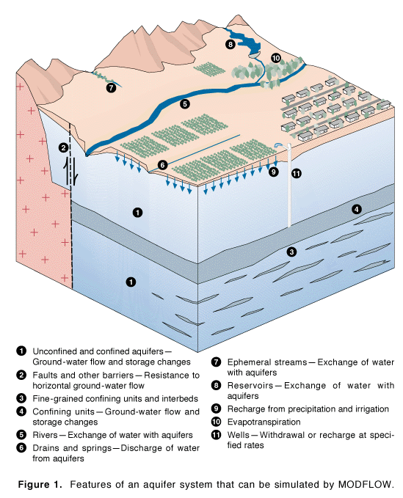
Developed by McDonald & Harbaugh of the USGS, 1983
Public Domain, open source
Most widely used groundwater model
Steady-state or transient saturated flow
Versions:
MODFLOW 88
MODFLOW 96
MODFLOW 2000
MODFLOW 2005
MODFLOW-NWT
MODFLOW-USG
MODFLOW 6

Slide 4
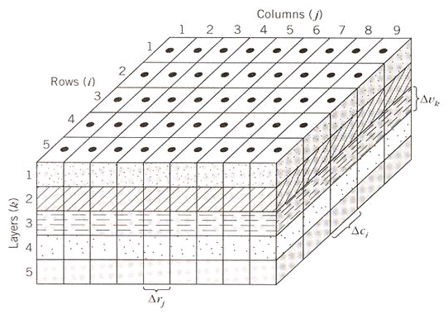
Finite Difference Model
3D Cartesian Grid Cell-Centered

Slide 5
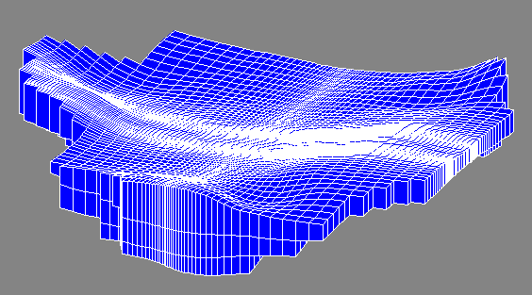
Grid Geometry
Orthogonal in xy
Thickness varies in z

Slide 6
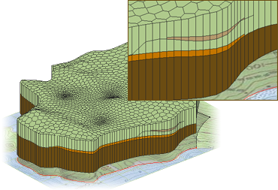
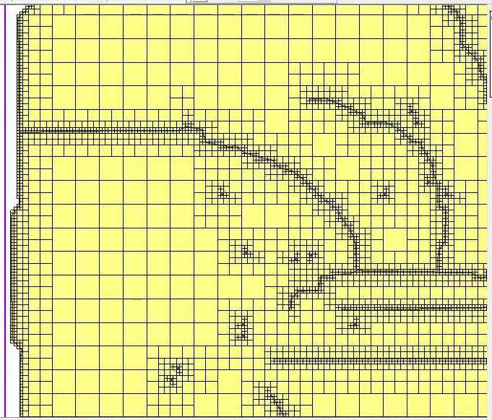
MODFLOW-USG
New version of MODFLOW that allows for unstructured grids (no rows/columns/layers). Uses finite volume formulation.
Allows for more efficient grid refinement around features where rapid head change occurs.

Slide 7
Governing Equation
where:
K_{xx}, K_{yy}, K_{zz} = values of hyd. cond. along xyz axes
h = total head
W = Sources and sinks
S_{s} = Specific storage
t = time

Slide 8
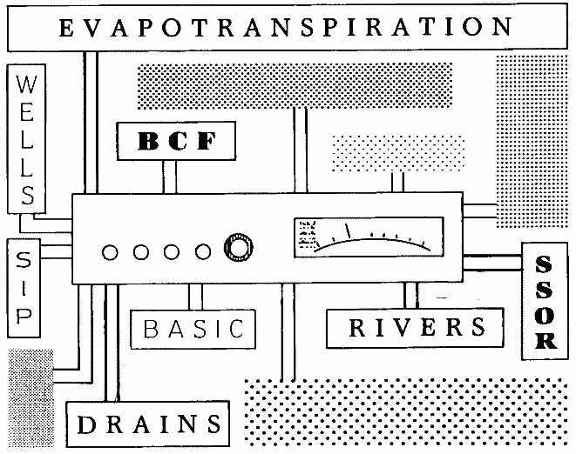
Processes & Packages
MODFLOW is divided into a series of processes & packages
Major tasks are organized as processes
More specific tasks are performed by packages
Each process may use one or more packages

Slide 9
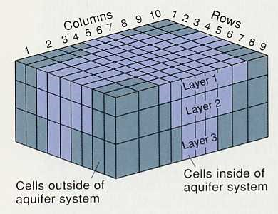
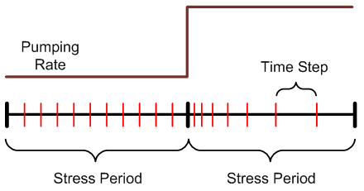
Global Process
Spatial discretization
# rows, cols, layers
Top/bottom elevations
Temporal discretization
Stress periods
Time steps
Units (ft vs m, etc)
Package Selection
Notes:
There is a layer discretization file and a global package file that are used by the Global Process.

Slide 10
Ground Water Flow Process
Formulation and solution of the ground water flow equation by the FD method
Main part of MODFLOW code
Includes
Flow package (BCF, LPF, or HUF)
Source/sink packages
Solvers

Slide 11
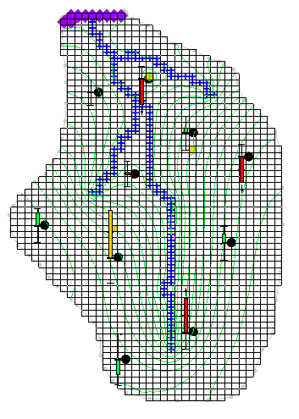
Observation Process
Used for model calibration
Calculates model-simulated heads and discharges to sources/sinks

Slide 12
Required Packages
Discretization
Rows, columns, layers (number and dimension)
Basic
Active cells (IBOUND)
Starting heads
Output Control
What should be written to output files and at what frequency
Flow Package (BCF, *LPF, HUF, UPW)
Aquifer properties (K, Ss, etc)
Solver (SIP, SSOR, *PCG, GMG, etc.)
*Default selection in GMS

Slide 13
Active/Inactive Zones
Cells outside problem domain are marked as inactive
Controlled by IBOUND array
(1=active, 0=inactive, -1=specified head)

Slide 14
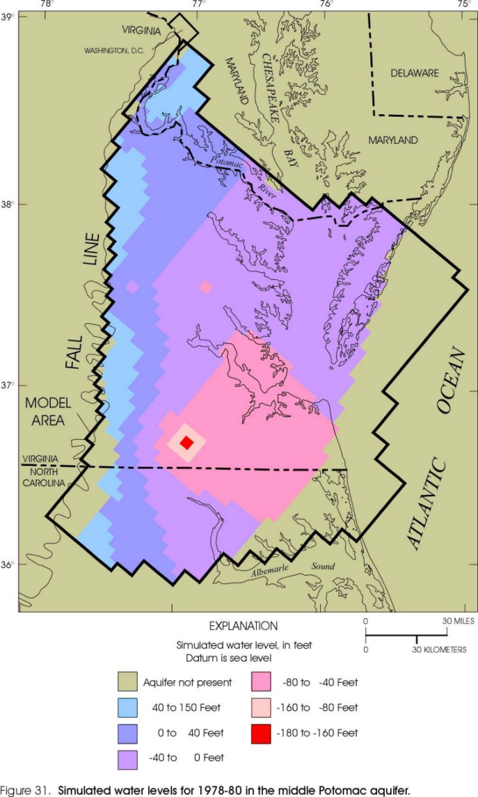
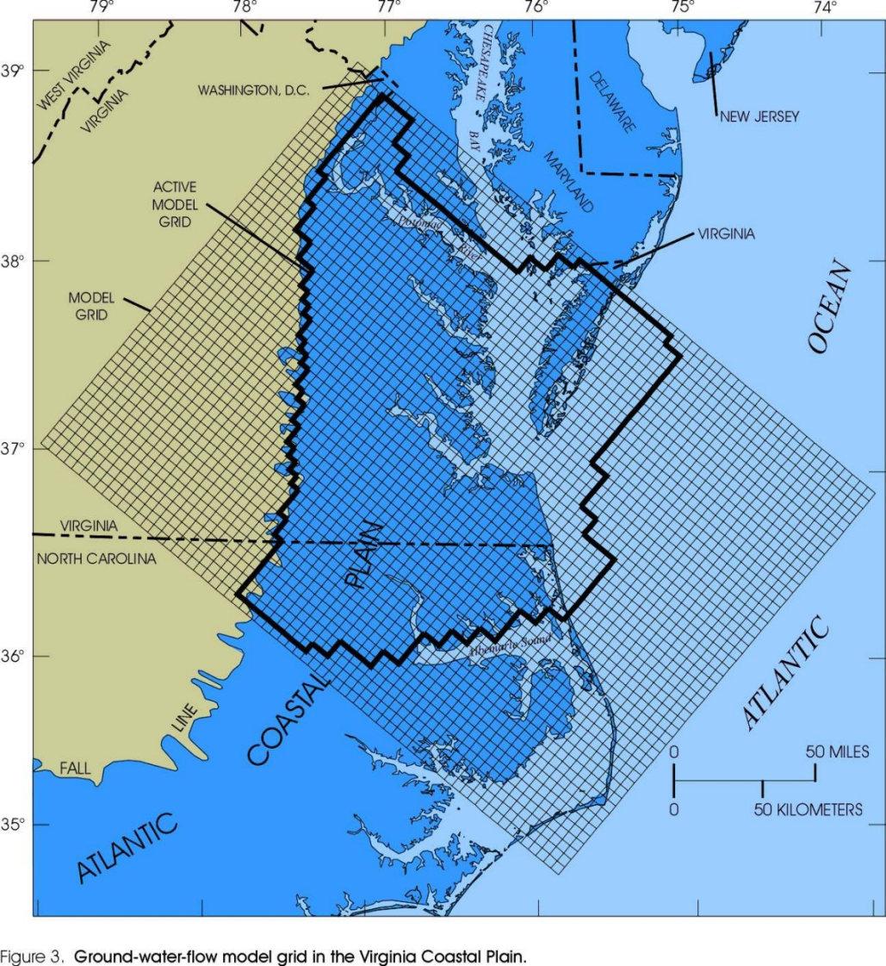
Virginia Coastal Plain Model
Notes:
http://va.water.usgs.gov/online_pubs/WRIR/98-4085/g-wfmcpasys_va.html

Slide 15
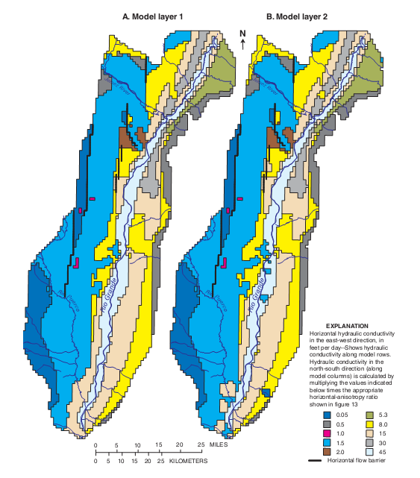
Flow Packages
Defines aquifer properties
Four options
Block-Centered Flow (BCF)
Layer Property Flow (LPF)*
Hydrogeologic Unit Flow (HUF)
Upstream Weighting (UPW), MODFLOW-NWT
*We will use the LPF package in this course

Slide 16
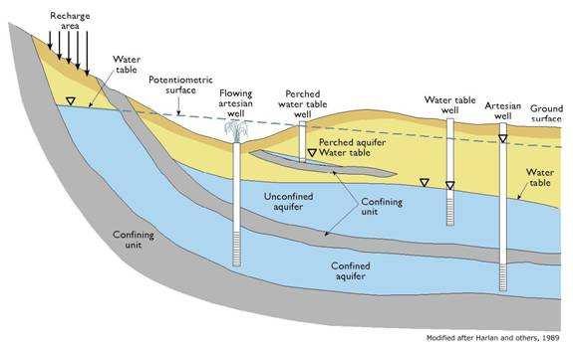
LPF - Layer Property Flow Package
User enters Kh, Kv and storage terms for all layers
Kv can be entered as directly or in terms of vertical anisotropy
Horizontal anisotropy entered on a cell-by-cell basis
Two layer types
Confined
Convertible

Slide 17
Optional Packages
CHB – Time Variant Specified Head
DRN – Drain
DRT – Drain Return Flow
ETS – Evapotranspiration Segments
EVT – Evapotranspiration
GAGE – Gage
GHB – General Head
HFB – Horizontal Flow Barrier
LAK – Lake
MNW – Multinode Well
MNW2 – Multinode Well 2
RCH – Recharge
RIV – River
SFR – Stream Flow Routing
STR – Stream-Aquifer Interaction
SUB – Subsidence
WEL – Well
UZF – Unsaturated Zone Flow
We will cover most of these in subsequent lectures

